Slide 2
Week 5 : Variables in Coding

Slide 3
Recap & Warm-up
What are some examples of loops?
What are conditional statements?
What are ways in which your program can become more interactive?

Slide 4
Class Rules & Expectations
Be respectful to others and the equipment ☺
Raise your hand to speak
Help others when needed
Actively participate
…and have fun learning and coding!

Slide 5
Hands-on Activity
We will need a scorekeeper to track favorite colors!
Choose one favorite color from the 3 and write down in your index card
Blue
Red
Green

Slide 6
Reflection
The scorekeeper kept track of how many times someone chose either Blue, Red or Green
Because the values associated with the colors chosen changed, we call them variables – because the values for the chosen colors varied
If we reset the count and ask again, the variables are all reset to an initial value (in this case, it is 0)

Slide 7
Variables
Variables are like a box that hold information
This information can change as the program runs
In Scratch, variables can hold numbers of words that the program can use, remember, or change
Everyday life examples
Scoreboard in sports (e.g. Football)
A shopping list full of different items you may want to buy
Can you cite some?

Slide 8
Types of Variables in Scratch
Global Variables
Variables that can be used by any sprite in the project
Local Variables
Variables that only one sprite can use

Slide 9
Activity: Bounce Counter
Goal : Make your Sprite bounce back when it touches the edge. If it bounces 4 times, make it say “I am done!” for 2 seconds and stop the game
BEFORE WE START THIS ACTIVITY, I WANT TO MAKE SURE THAT EVERYONE IS LOGGED INTO THEIR ACCOUNTS ON SCRATCH.

Slide 10
Activity: Bounce Counter
Step 1 : Create a Variable to Count the Bounces:
Go to the Variables category.
Click “Make a Variable” and name it “Score".
This variable will keep track of how many times the sprite has bounced off the edge.
Step 2 : Set Up the Initial Conditions:
Go to the Events category and drag the “when green flag clicked” block to start the program.
Underneath it, go to the Variables category and add the “set Score to 0” block. This will reset the bounce count to 0 each time the game starts.

Slide 11
Activity: Bounce Counter
Step 3 : Create a Forever Loop to Check for Edge Touching:
Go to the Control category and add a “forever” loop. This will allow the sprite to continuously move and check for the edge.
Step 4 : Add Movement and Edge Detection:
Inside the forever loop, go to the Motion category and add “move 10 steps”.
Directly underneath, add “if then” block
Add a “touching edge” from the Motion category inside the if condition

Slide 12
Activity: Bounce Counter
Step 5 : Turning to the other side
Below the “if” block, add a turn 180 degrees control from the motion block.
Step 6 : Increase Bounce Count When Bouncing:
After the “turn” block, add “change Score by 1” from the Variables category. This increases the bounce count by 1 each time the sprite bounces.

Slide 13
Activity: Bounce Counter
Step 7 : Reaching the desired count and closing out the game!
Below the “change” block, add another “if” conditional block
Drag the = operator into the if block
Drag the Score variable and make that equal to 3 implying that when the score hits 3, we will say something and close the game
Use the “say” block for 2 seconds and write a message that indicates “I am done playing this game!”
Finally, drag the “stop all” block below the say looks block – this will stop the game from proceeding

Slide 14
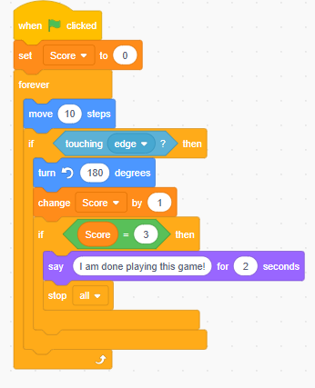
Activity: Bounce Counter

Slide 15
Saving the project
It makes sense to save your hard work so that you can access it with ease in the future.
To do this, go to the File folder in the menu bar
Hit “Save to your computer”
Type in “If Conditional” for your sprite icon in the section Save as…
And choose wherever you’d like to store it, such as Desktop or My Projects

Slide 16
Next steps?
Take a couple minutes to start brainstorming ideas for your game that we will build next week!

Slide 17
Recap & Quiz
What is a variable?
Can you give me an example of when you might use a variable in a game?
Are there examples where you would use variables to store different things? How?

Slide 18
Next week
Project Week & Showcase
Project ideas (the below are just some examples)
Quiz Game – Build a simple quiz with questions and a scoring system
Obstacle Avoidance Game – Guide your sprite through moving obstacles
Space Adventure Game – Control a spaceship to collect stars and avoid asteroids

Slide 19
End of Class Survey
Today, I learned ______________, I need help with ________________
I would like to learn more about ______________________________

Slide 20
THANK YOU

Slide 21
Class Schedule
Class 1 : Introduction to basic concepts & Scratch
Class 2 : Sequencing & Event-driven Programming
Class 3 : Loops & Iteration
Class 4 : Conditionals & Decision Making
Class 5 : Variables
Class 6 : Final Project & Showcase

