Slide 1



Slide 2
Week 2 : Sequencing & Event-Driven Programming

Slide 3
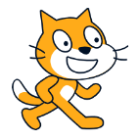
Recap & Warm-up
What is an algorithm?
What does “Change size by 10” do in Scratch?
How is an algorithm different from a program?
What is a loop? Why would you think this would be needed?

Slide 4
Class Rules & Expectations
Be respectful to others and the equipment ☺
Raise your hand to speak
Help others when needed
Actively participate
…and have fun learning and coding!

Slide 5

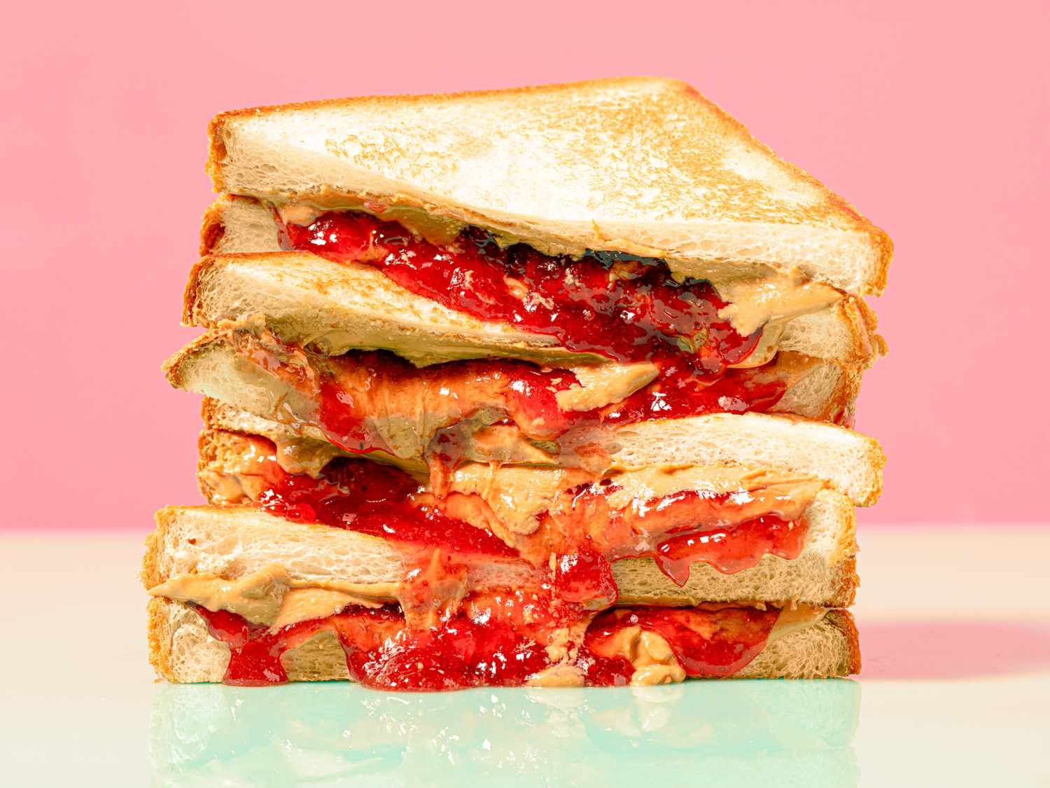
Activity: Sequencing
Have a Robot make 10 peanut butter and jelly sandwiches
Take 8 minutes to write down steps on paper

Slide 6
Activity Thoughts
Did anyone forget to instruct the robot to:
  Open the bag of bread?
  Lay the bread on the table?
  Open the jelly and peanut butter bottles?
  Use knives to spread the jelly and peanut butter?
  Close the lids when done?
What about?
  What if the bottle ran out of peanut butter and jelly?
  What if our robot runs out of bread?

Slide 7
What is Sequencing?
Sequencing is the specific order of steps in a program
Why sequence?
  Ensures tasks are completed in a certain and correct order
  Helps make things repeatable and predictable
In scratch, blocks can stack vertically on top of each other to create sequences

Slide 8
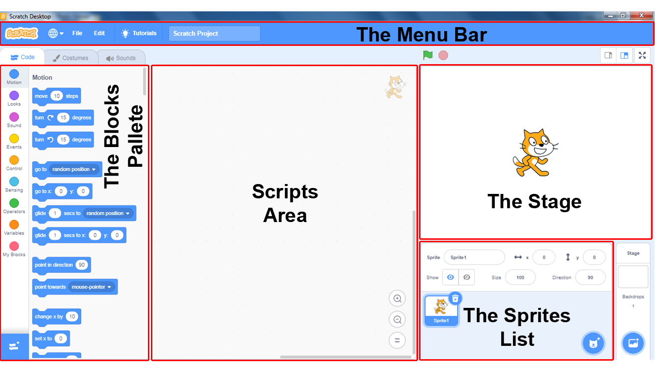
…from our previous meeting..
Stage is at upper right (where actors act and info is shown)
Sprite is another name for actor.
“Pallets” or Instruction menus at left contain pre-defined instructions for actors
Scripts (another name for a program) tells the actor what to do
Script area in the center is where scripts are written for actors to perform

Slide 9
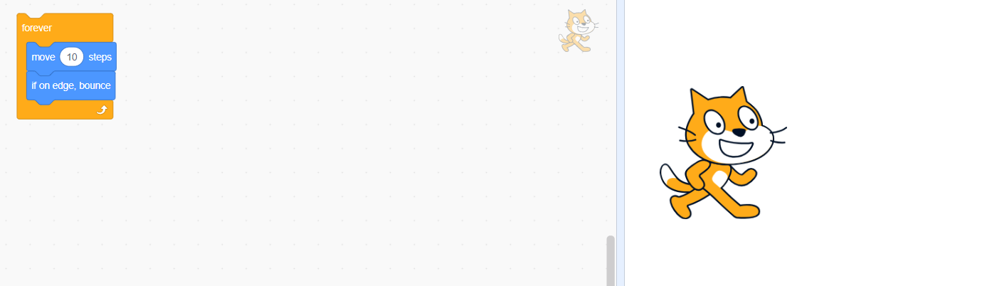
Creating Sprite Movement
Using the cat sprite
Select the Motion menu
Use the 'Move 10 steps' block to make the sprite move.
Now, select the Control menu
Pick up the forever block and position the ‘Move 10 steps’ inside it
Add 'If on edge, bounce' to make the sprite bounce when it hits the screen edge.
Click on the block
What happens?

Slide 10
Event-Driven Programming
Code that runs in response to an action or an “event”
Examples of events in Scratch :
  Key presses
  Mouse clicks
Events allow sprites to react dynamically, creating interactive programs

Slide 11


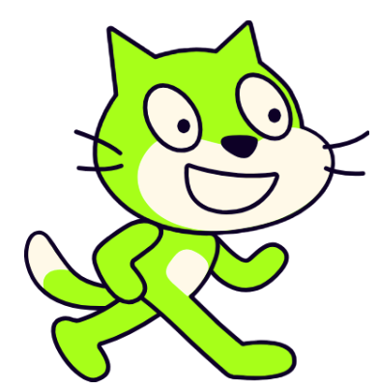


Activity
In the “Events section”, click and drag
Under “Looks” select
Then change color effect by 25 ->
Then change size by 100 ->
Try clicking on the sprite to start your program. It should mirror the image on the right.
Woohoo you did it!

Slide 12

Sound
We’ll now try and make our cat purr!
Go to the “Sound” block.
Select the
Drag it right below the “when this sprite clicked”
Click on your sprite to run the code
What do you hear? ☺

Slide 13
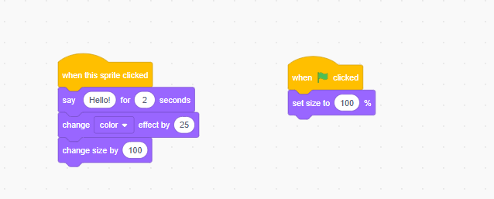



Resetting the Size
Notice that we are having a problem with the size of the sprite. It becomes bigger whenever you run the blocks.
We can fix this!
Drag a
Then, drag a
Now click the sprite then click
and put it separately from the other stack
and place it under the one above
and see what happens!

Slide 14

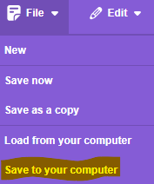
Saving the project
It makes sense to save your hard work so that you can access it with ease in the future.
To do this, go to
Hit
Type in “Project1” for your cat icon in the section Save as…
And choose wherever you’d like to store it, such as Desktop or My Projects
in the purple bar near the top

Slide 15
Recap & Quiz
Why is sequencing important in coding?
What is an event in Scratch?
How does event-driven coding make games interactive?

Slide 16
End of Class Survey
Today, I learned ______________, I need help with ________________
I would like to learn more about ______________________________

Slide 17

THANK YOU

