Slide 2
Week 1 : Intro to Computer Science & Scratch Programming

Slide 3
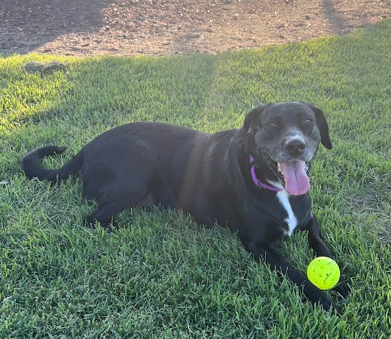
A little bit about me..
Junior at Cedar Ridge High
STEM geek!
My family and I have a mixed lab named Luna
I love to play tennis and listen to music in my free time

Slide 4
Introductions
Name + age
If you could create any game, what would it be about?
If you could have any superpower, what would it be?
What do you like to in your free time?

Slide 5
Class Rules & Expectations
What rules would you set for this class?

Slide 6
Class Rules & Expectations
Be respectful to others and the equipment ☺
Raise your hand to speak
Help others when needed
Actively participate
…and have fun learning and coding!

Slide 7
Experience check
Have you ever used a computer to create something fun?
Have you tried coding before? What did you make?
Do you play games on a computer or phone? What do you like about them?

Slide 8
Course Outline
This 6-week class will introduce you to:
Key computer science concepts like algorithms, sequencing, loops, and variables.
Problem-solving skills through computational thinking and coding activities.
Programming fundamentals using Scratch to create interactive projects.
Creative and collaborative learning through fun, hands-on activities.
Complete a Scratch project to showcase coding skills and understanding.

Slide 9
Class Schedule
Class 1 : Introduction to basic concepts & Scratch
Class 2 : Sequencing & Event-driven Programming
Class 3 : Loops & Iteration
Class 4 : Conditionals & Decision Making
Class 5 : Variables
Class 6 : Final Project & Showcase

Slide 10
What is Computer Science?
Computer Science is how we solve a variety of problems using computers.
It includes programming, creating games, and using algorithms.
We give computers instructions to do things like animations, games and much more.
Who or what powers the internet?

Slide 11
Who computes?
Engineers
Businessmen
Artists
FBI Agents
Brain surgeons
Gamers…and more
Everyone uses information in some way. Computers process all sorts of information for a variety of needs.
Can you think of others who compute and why?

Slide 12
Activity : What is an Algorithm?
How do we go about making and baking a cake?
Take 7 minutes to write down steps on paper

Slide 13
What is an Algorithm?
Step by step instructions to solve a problem
Just like you, it needs a clear set of steps to follow
In coding, or a programming language, algorithms tell a computer what to do, step by step

Slide 14
Input, Process and Output
Input: You give instructions (e.g., pressing a button or clicking).
Process: The computer follows your instructions and runs the code.
Output: The computer does something (e.g., moves a sprite or plays a sound).
Notes:
Give example of ice cream truck here.

Slide 15
Program
Set of instructions that tells a computer what to do. These are written in an artificial (non-speaking) language.
Also referred to as code or computer code.
Difference between Algorithm and Program
Algorithm = Plan or instructions – these aren’t specific to a language or a computer
Program = Code that follows the plan and runs on a computer. Stuff that is written in a way that the computer understands and executes.

Slide 16
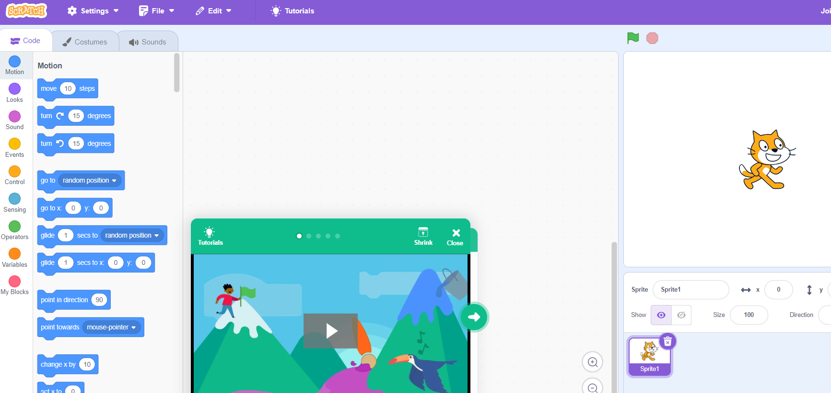
Scratch Programming

Slide 17
Scratch
Simple and elegant, easy to use programming website
Fun and easy to use
https://scratch.mit.edu
Click Join, create a username
+ password you can remember

Slide 18
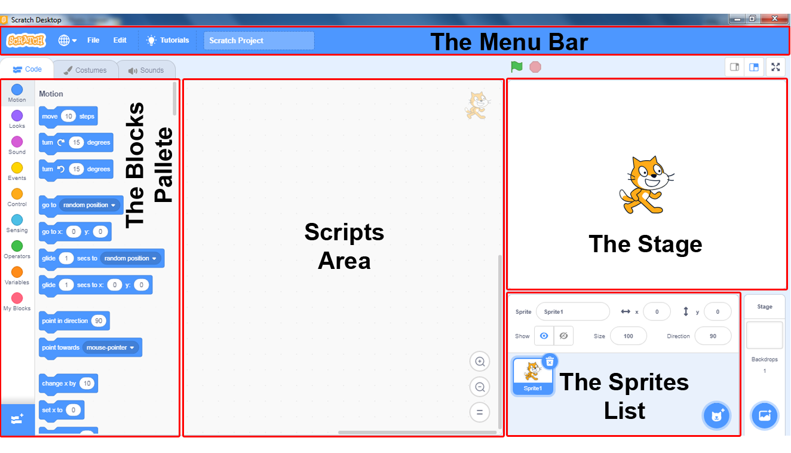
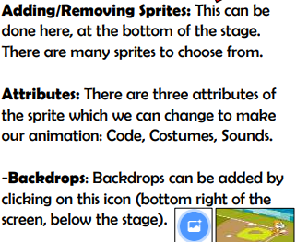
The Scratch Environment
Stage is at upper right (where actors act and info is shown)
Sprite is another name for actor.
“Pallets” or Instruction menus at left contain pre-defined instructions for actors
Scripts (another name for a program) tells the actor what to do
Script area in the center is where scripts are written for actors to perform

Slide 19
The “Hello” script / program
We will start with the Cat sprite
Click on Events
Then click
Select the Looks menu
Click on
Now click
VOILA – Your very first scratch program!
and drag it to the middle
and drag it to the middle
in the top right corner

Slide 20
Try some other Looks operations
Change color effect by 25
Change color effect by 25 again
Hide
Show
Change size by 10
Change size by 10 again
Set size to 100%

Slide 21
Try this yourself
Say “hello” for 2 seconds
Then change color by 25
Then think “Hmm..” for 4 seconds
Then change color by 75
Then change size by 200
Drag each instruction from the menu to the center script area. Connect them into a single block. Edit the parameters to get the numbers we want.

Slide 22
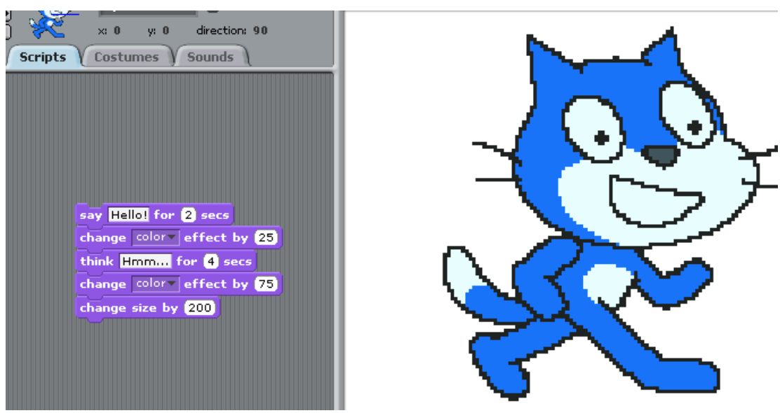
Output
Make sure the first block is “when clicked”
How far along did you get?

Slide 23
Recap & Quiz
What is an algorithm?
What does “Change size by 10” do in Scratch?
How is an algorithm different from a program?

Slide 24
End of Class Survey
Today, I learned ______________, I need help with ________________
I would like to learn more about ______________________________

Slide 25
THANK YOU

